Slide 1
Lecture 1 : Chemistry

Slide 2

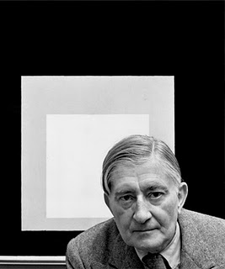
Teaching Philosophy
“Good teaching is more a giving of right questions than a giving of right answers.”
Josef Albers
1888-1976

Slide 3
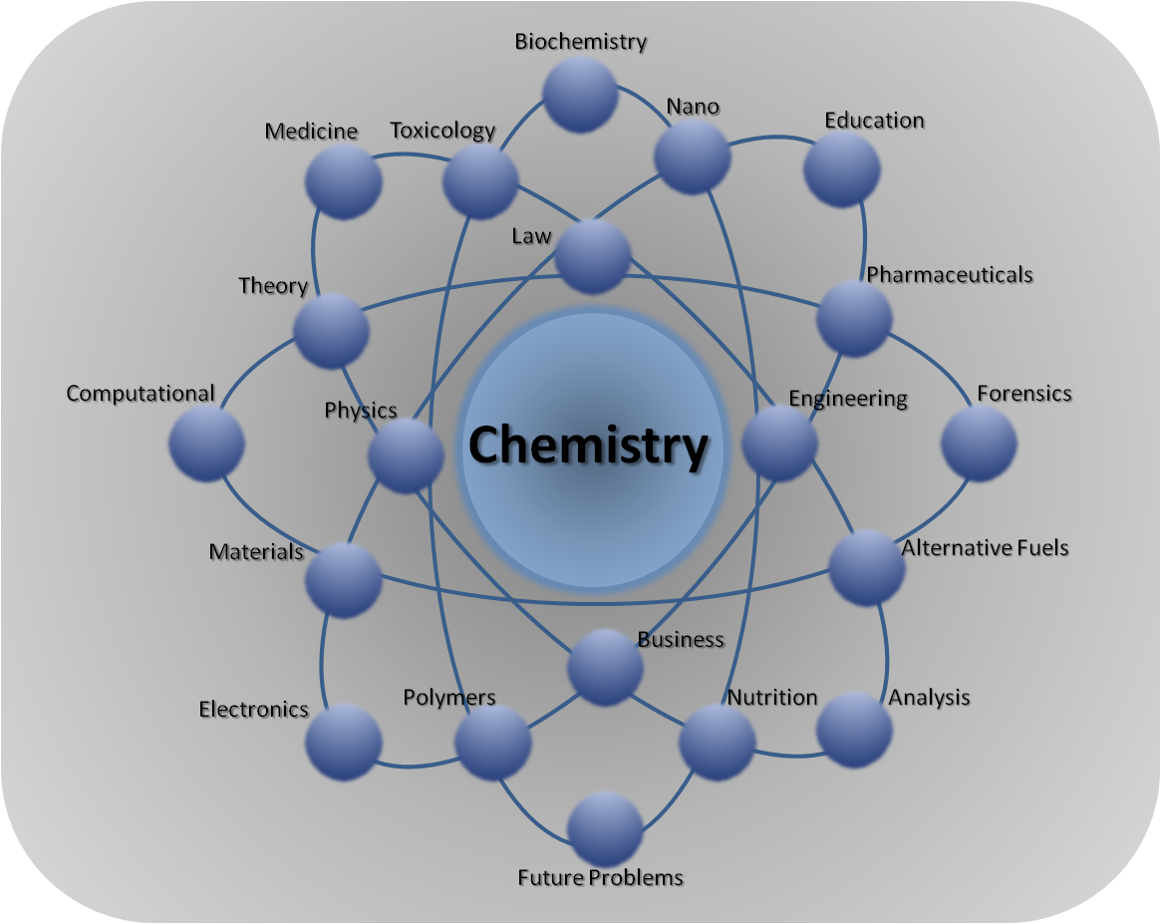
Chemistry: The Central Science
Chemistry is sometimes known as the 'central science' because it helps to connect physical sciences, like maths and physics, with applied sciences, like biology, medicine and engineering.
Can you think of something with no chemistry?

Slide 4
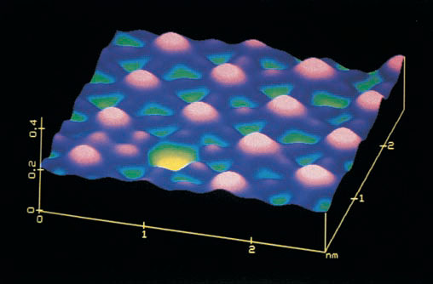
Atomic Structure
STM image of iodine atoms on a platinum metal surface

Slide 5
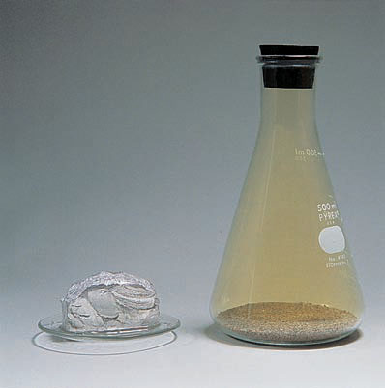
What happens if we mix them?
Na metal cannot be handled with bare fingers, because it reacts with any moisture on the skin, causing a burn
Cl₂ is a poisonous, greenish yellow gas with a choking odor

Slide 6
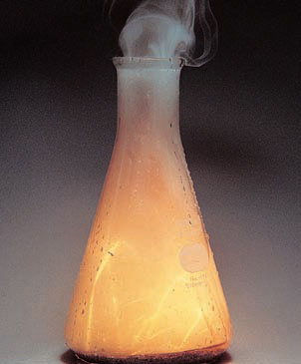
What Happens if We Mix Them?
Chemical combination of two toxic substances produces sodium chloride, the substance that we commonly call table salt.

Slide 7
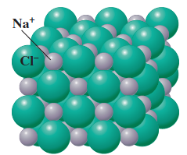
Basic Concepts of Chemistry
How do we explain the differences in properties of different forms of matter?
We need to understand:
Atomic Structure
Periodic Table
Chemical Bond
In the next three chapters we will develop these concepts

Slide 8
What is Atom?
Atomic Theory
John Dalton (1766-1844)
All matter—whether element, compound, or mixture—is composed of small particles called atoms
Dalton’s Atomic Theory
All matter is composed of indivisible atoms. An atom is an extremely small particle of matter that retains its identity during chemical reactions.
An element is a type of matter composed of only one kind of atom, each atom of a given kind having the same properties. Mass is one such property.
A compound is a type of matter composed of atoms of two or more elements chemically combined in fixed proportions.
A chemical reaction consists of the rearrangement of the atoms present in the reacting substances to give new chemical combinations present in the substances formed by the reaction. Atoms are not created, destroyed, or broken into smaller particles by any chemical reaction.

Slide 9
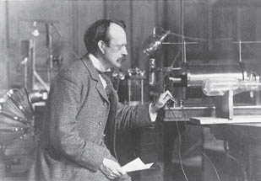
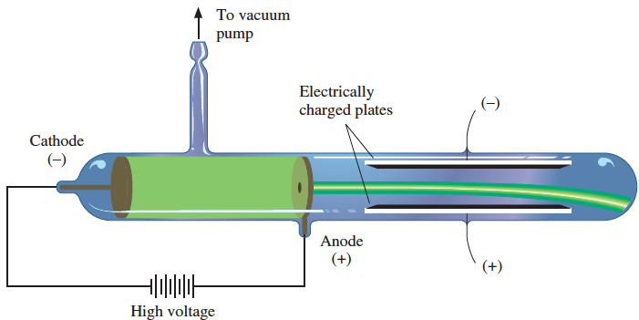
Discovery of the Electron
Atomic Theory
J. J. Thompson (1856-1940)
Won Nobel Prize in physics in 1906

Slide 10
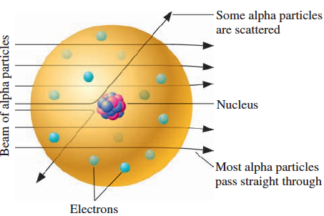
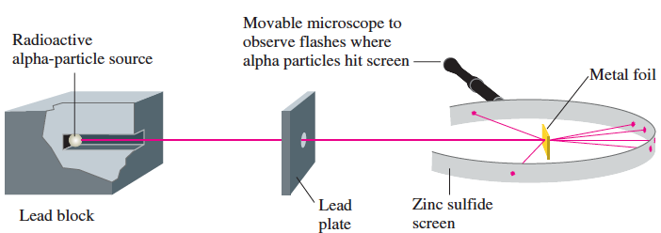
Discovery of the Nucleus
Atomic Theory
Ernest Rutherford (1871–1937)

Slide 11
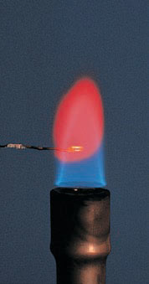
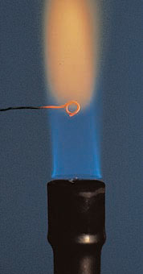
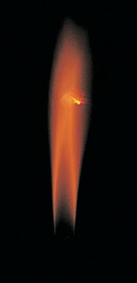
Flame Tests of Elements
According to Rutherford’s Model an atom consists of a nucleus many times smaller than the atom itself, with electrons occupying the remaining space.
How are the electrons distributed in this space?
What are the electrons doing in the atom?
When metal compounds burn in a flame, they emit bright colors
The light from a flame, when passed through a prism, shows a cluster of colored lines – ‘Line Spectrum’
Li Na Ca

Slide 12
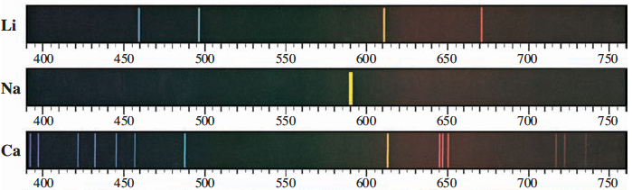
Flame Tests: Line Spectra
The spectra can be used to identify elements
How is it that each atom emits particular colors of light?
What does a line spectrum tell us about the structure of an atom?
If you know something about the structures of atoms, can you explain the formation of ions and molecules?
We will answer these questions in this and the next chapter

Slide 13
Explanation of Line Spectra
Electronic Structure of Atoms
Formation of Chemical Bond
To understand the line spectrum from the colored light produced in hot gases and flames we need to discuss first, ‘the nature of light’

Slide 14
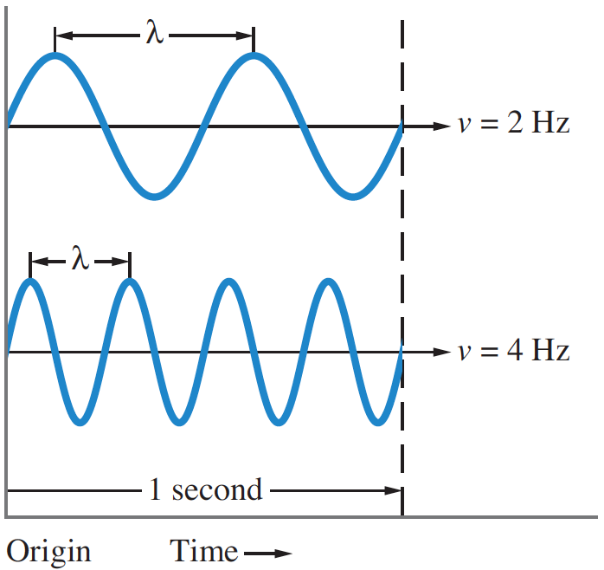
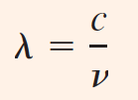
The Wave Nature of Light
The speed of light waves, c, is 3.00 × 10⁸ m/s
This speed ‘c’ in a vacuum is a constant and is independent of wavelength or frequency.

Slide 15
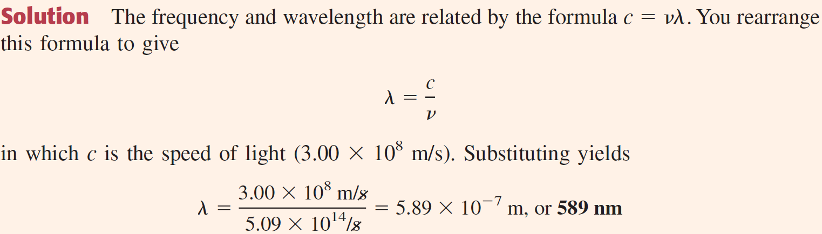
Obtaining the Wavelength of Light from its Frequency
Problem 1. What is the wavelength of the yellow sodium emission, which has a frequency of 5.09 × 10¹⁴/s?
Similarly, you can obtain the frequency of light from its wavelength

Slide 16
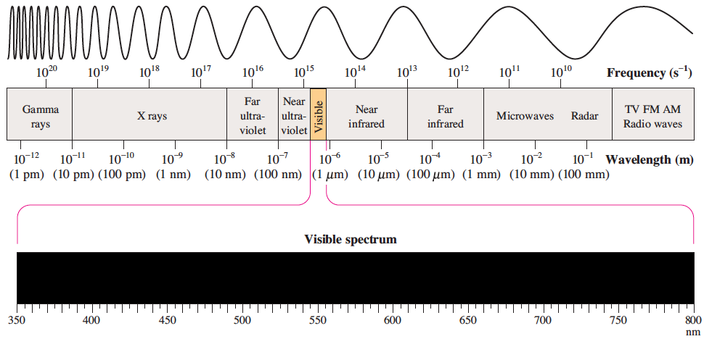
Electromagnetic Spectrum
The range of frequencies or wavelengths of electromagnetic radiation is called the electromagnetic spectrum,

Slide 17
Quantum Effects and Photons
Isaac Newton believed that light consisted of a beam of particles.
In 1801, however, British physicist Thomas Young showed that light, like waves, could be diffracted.
(Diffraction is a property of waves in which the waves spread out when they
encounter an obstruction or small hole.)
In 1905 the German physicist Albert Einstein (1879–1955; emigrated to the United States in 1933) discovered that he could explain a phenomenon known as the photoelectric effect by postulating that light had both wave and particle properties.
Einstein based this idea on the work of the German physicist Max
Planck (1858–1947).

Slide 18
Planck’s Quantization of Energy
In 1900 Max Planck (won Nobel prize in 1918) found a theoretical formula that exactly describes the intensity of light of various frequencies emitted by a hot solid at different temperatures
According to Planck, the atoms of the solid oscillate, or vibrate, with a definite frequency ν, depending on the solid.
An atom could have only certain energies of vibration, E, those allowed by the formula
E = nhν, n = 1, 2, 3, . . .
where h is Planck’s constant, having the value 6.63 × 10⁻³⁴ J.s.
The value of n must be 1 or 2 or some other whole number.
The numbers symbolized by n are called quantum numbers.
The vibrational energies of the atoms are said to be quantized; that is, the possible energies are limited to certain values.

Slide 19
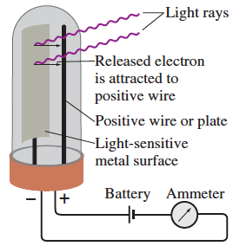
Photoelectric Effect
Einstein postulated that light consists of quanta (now called photons), with energy E proportional to the observed frequency of the light: E = hν
The photoelectric effect is the ejection of electrons from the surface of a metal or from another material when light shines on it.
Electrons are ejected only when the frequency of light exceeds a certain threshold value characteristic of the particular metal.
For example, violet light will cause potassium metal to eject electrons, no amount of red light (lower frequency) has any effect.

Slide 20
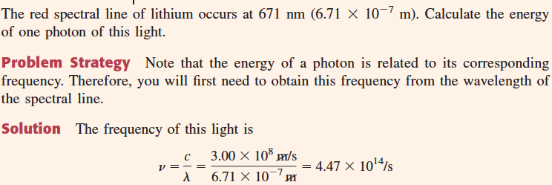
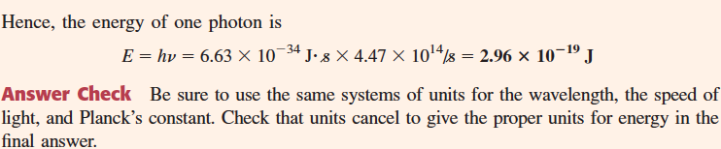
Calculating the Energy of a Photon

Slide 21
Limitations of Rutherford’s Nuclear Model
Rutherford’s nuclear model
the atom consists of a nucleus with most of the mass of the atom and a positive charge, around which move enough electrons to make the atom electrically neutral.
Limitations
An electrically charged particle (such as an electron) that revolves around a center would continuously lose energy as electromagnetic radiation and thus would spiral into the nucleus.
The stability of the atom could not be explained.
A solution to this theoretical dilemma was found in 1913 by Niels Bohr, a Danish physicist.
Using the work of Planck and Einstein, Bohr applied a new theory to the simplest atom, hydrogen.

Slide 22
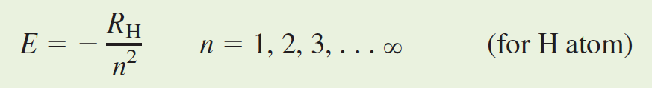
Bohr’s Postulates
Postulates are to account for
the stability of the hydrogen atom and
the line spectrum of the atom.
Energy-level Postulate: An electron can have only specific energy values in an atom, which are called its energy levels. Therefore, the atom itself can have only specific total energy values.
where R_{H} is a constant with the value 2.179 × 10⁻¹⁸ J, and
n is called the principal quantum number, which can have only the integer values 1, 2, 3, and so forth (up to infinity).

Slide 23
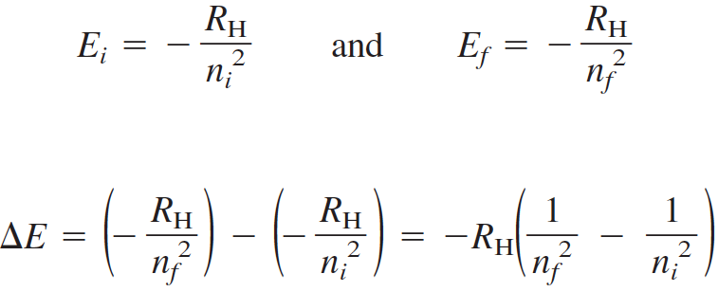
Bohr’s Postulates
Transitions Between Energy Levels: An electron in an atom can change energy only by going from one energy level to another energy level. By so doing, the electron undergoes a transition.
An electron in a higher energy level (initial energy level, E_{i}) undergoes a transition to a lower energy level (final energy level, E_{f}). In this process, the electron loses energy, which is emitted as a photon.
The energy lost by the hydrogen atom is ΔE = E_{f} – E_{i}

Slide 24
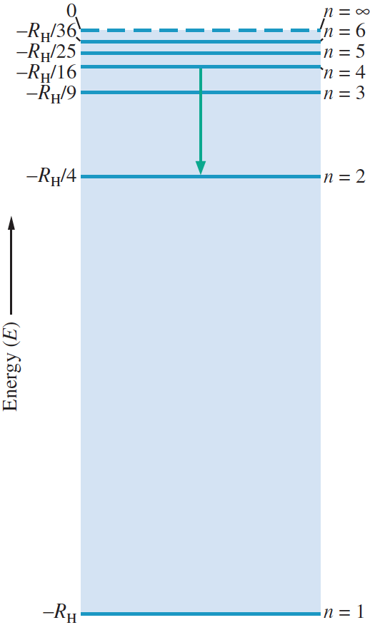
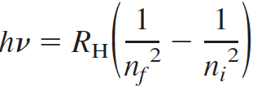
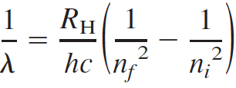
The energy of the emitted photon, ην, equals the energy lost by the atom (ΔE):
Energy of emitted photon = ην = − ΔE
= −(E_{f} − E_{i})
That is,
Recalling that ν= c/λ, you can rewrite this as

Slide 25
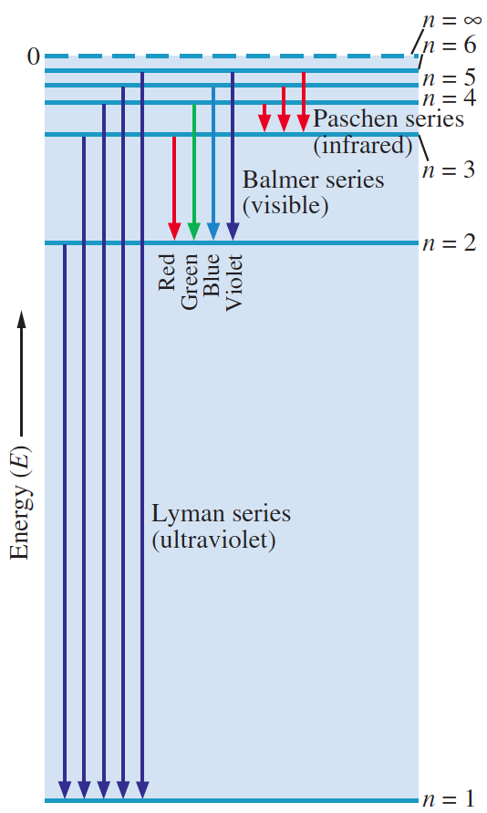
Transitions of the electron in the hydrogen atom:
The diagram shows the Lyman, Balmer, and Paschen series of transitions that occur for n_{f} = 1, 2, and 3, respectively.

Slide 26
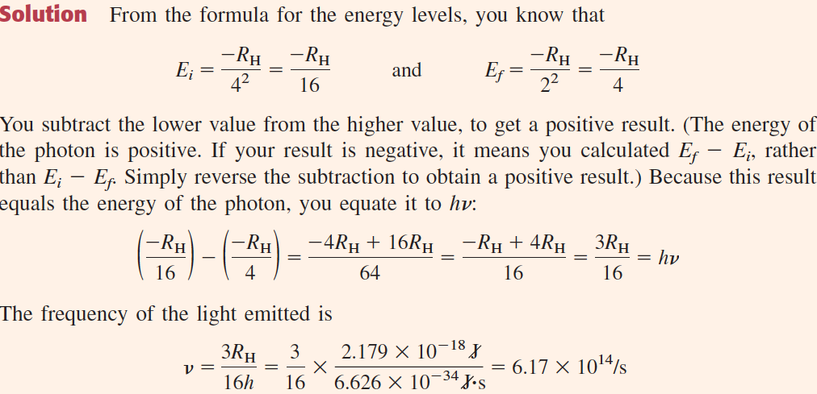
What is the wavelength of light emitted when the electron in a hydrogen atom undergoes a transition from energy level n = 4 to level n = 2?

Slide 27
Quantum Mechanics
Bohr’s theory was unsuccessful, however, in accounting for the details of atomic structure and in predicting energy levels for atoms other than hydrogen
Current ideas about atomic structure depend on the principles of quantum mechanics, a theory that applies to submicroscopic particles of matter, such as electrons.
The development of this theory was stimulated by the discovery of the de Broglie relation.

Slide 28
de Broglie Relation
According to Einstein, light has not only wave properties but also particle properties.
For example, a particle of light, the photon, has energy
E = hν = hc/λ
Again, from the theory of relativity E = mc²
Combining these two equations:
the momentum of photon, mc, is related to the wavelength of the light:
mc = h/λ
or, λ = h/mc.
de Broglie reasoned that if light (considered as a wave) exhibits particle aspects, then perhaps particles of matter show characteristics of waves. Therefore a particle of matter of mass m and speed v has an associated wavelength, by analogy
with light:
The equation λ = h/mv is called the de Broglie relation.
If matter has wave properties, why are they not commonly observed?

Slide 29
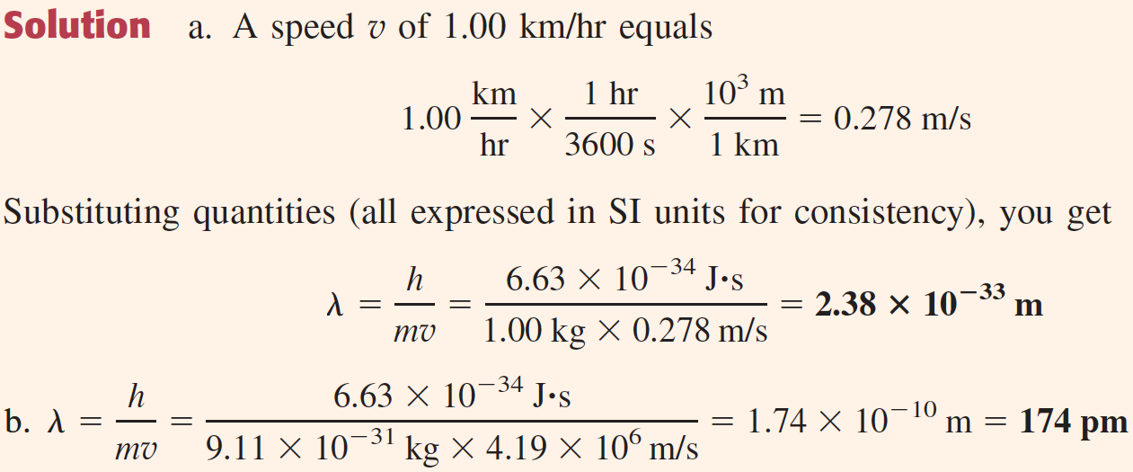
Wavelength of a Moving Particle
a. Calculate the wavelength (in meters) of the wave associated with a 1.00-kg mass moving at 1.00 km/hr. b. What is the wavelength (in picometers) associated with an electron, whose mass is 9.11 × 10⁻³¹ kg, traveling at a speed of 4.19 × 10⁶ m/s?
For 1 kg mass, the wavelength is so incredibly small that such waves cannot be detected. Under the proper circumstances, the wave character of electrons should be observable.

Slide 30
Wave Mechanics
de Broglie’s relation cannot be applied directly to an electron in an atom, where the electron is subject to the attractive force of the nucleus.
Schrödinger devised a theory to find the wave properties of electrons in atoms and molecules.
The branch of physics that mathematically describes the wave properties of submicroscopic particles is called quantum mechanics or wave mechanics.

Slide 31
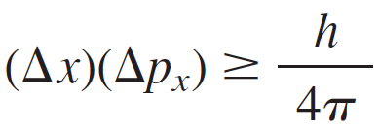
Heisenberg’s Uncertainty Principle
Heisenberg showed from quantum mechanics that it is impossible to know simultaneously, with absolute precision, both the position and the momentum of a particle such as an electron.
Heisenberg’s uncertainty principle is a relation that states that the product of the uncertainty in position and the uncertainty in momentum of a particle can be no smaller than Planck’s constant divided by 4π.
Where, Δx is the uncertainty in the x coordinate of the particle and Δp_{x} is the uncertainty in the momentum in the x direction.

Slide 32
Schrödinger Wave Equation
HΨ = EΨ
H is the Hamiltonian Operator
E is the Energy

Slide 33
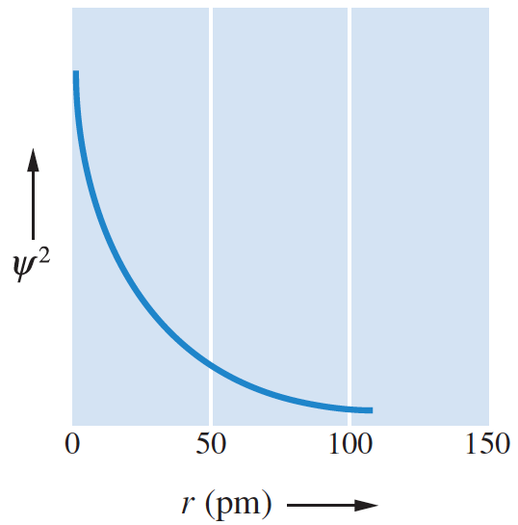
Wave Functions
Information about a particle in a given energy level (such as an electron in an atom) is contained in a mathematical expression called a wave function, denoted by the Greek letter psi, Ψ.
The wave function is obtained by solving an equation of quantum mechanics (Schrödinger’s equation).
Ψ², gives the probability of finding the particle within a region of space.
The wave function and its square, Ψ², have values for all locations about a nucleus.
Ψ² is large near the nucleus (r = 0), indicating that the electron is most likely to be found in this region.
The value of Ψ² decreases rapidly as the distance from the nucleus increases, but Ψ² never goes to exactly zero.

Slide 34
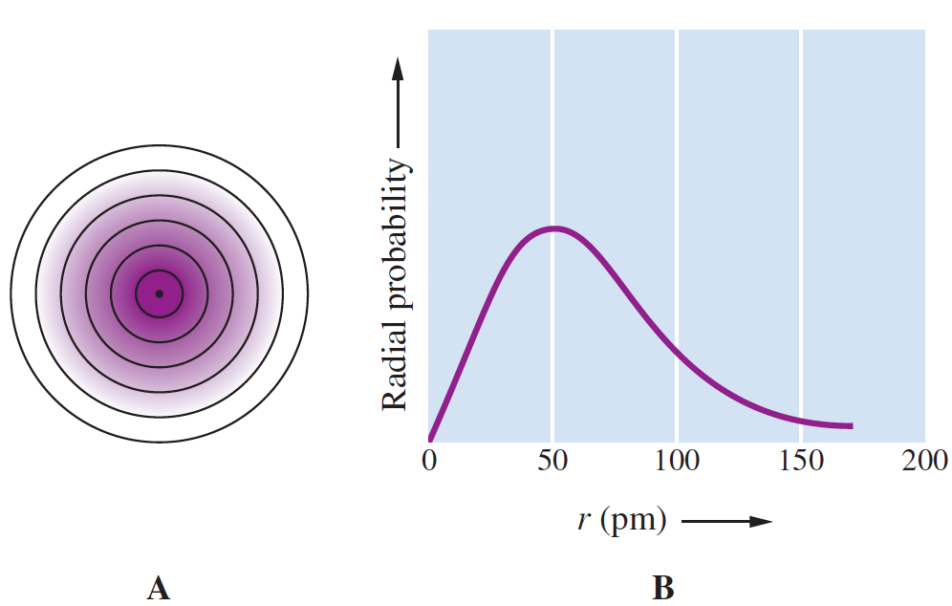
Wave Functions
The diagram shows the probability density for an electron in a hydrogen atom. The region is marked off in shells about the nucleus.
The graph shows the probability of finding the electron within shells at various distances from the nucleus (radial probability).

Slide 35
Quantum Numbers and Atomic Orbitals
Each electron in an atom is described by four different quantum numbers, three of which (n, l, and m_{l}) specify the wave function that gives the probability of finding the electron at various points in space.
A wave function for an electron in an atom is called an atomic orbital. An atomic orbital is pictured qualitatively by describing the region of space where there is high probability of finding the electrons.
A fourth quantum number (m_{s}) refers to a magnetic property of electrons called spin.
We first look at quantum numbers, then at atomic orbitals.

Slide 36
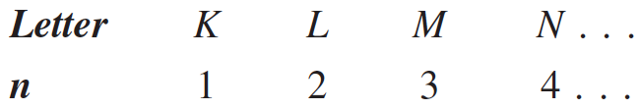
Principal Quantum Number
Principal Quantum Number (n): This quantum number is the one on which the energy of an electron in an atom principally depends.
It can have any positive value: 1, 2, 3, and so on.
The energy of an electron in an atom depends principally on n. The smaller n is, the lower the energy.
The size of an orbital also depends on n. The larger the value of n is, the larger the orbital. Orbitals of the same quantum state n are said to belong to the same shell.
Shells are sometimes designated by the following letters:

Slide 37
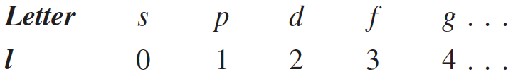
Angular Momentum QN
2. Angular Momentum QN or Azimuthal QN (l): This quantum number distinguishes orbitals of given n having different shapes
It can have any integer value from 0 to n – 1.
Within each shell of QN n, there are n different kinds of orbitals, each with a distinctive shape denoted by an l QN.
Although the energy of an orbital is principally determined by the n QN, the energy also depends somewhat on the l QN. For a given n, the energy of an orbital increases with l.
Orbitals of the same n but different l are said to belong to different subshells of a given shell.
The different subshells are usually denoted by letters as follows:
Notes:
For example, if an electron has a principal quantum number of 3, the possible values for l are 0, 1, and 2. Thus, within the M shell (n = 3), there are three kinds of orbitals, each having a different shape for the region where the electron is most likely to be found. in this section.

Slide 38
Magnetic QN
3. Magnetic Quantum Number (m_{l}): This quantum number distinguishes orbitals of given n and l — that is, of given energy and shape but having a different orientation in space
The allowed values are the integers from -l to +l.
The orbitals have the same shape but different orientations in space.
All orbitals of a given subshell have the same energy.
There are 2l + 1 orbitals in each subshell of QN l.
Notes:
For example, if an electron has a principal quantum number of 3, the possible values for l are 0, 1, and 2. Thus, within the M shell (n = 3), there are three kinds of orbitals, each having a different shape for the region where the electron is most likely to be found. in this section.

Slide 39
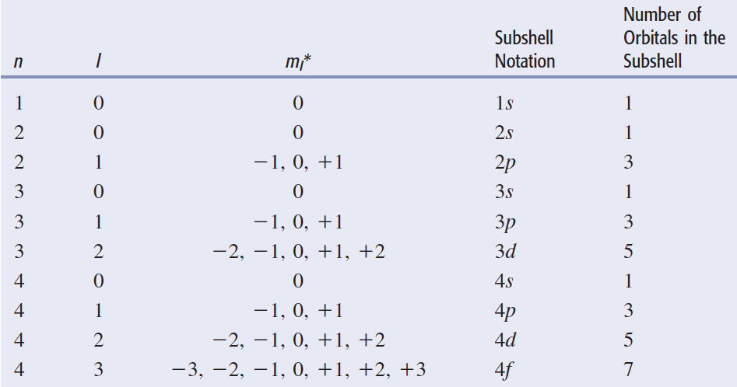
Permissible Values of QN for Atomic Orbitals

Slide 40
Spin QN
4. Spin Quantum Number (m_{s}): This quantum number refers to the two possible orientations of the spin axis of an electron
Possible values are +1/2 – and -1/2.
An electron acts as though it were spinning on its axis like the earth.
Such an electron spin would give rise to a circulating electric charge that would generate a magnetic field.
In this way, an electron behaves like a small bar magnet, with a north and a south pole.

Slide 41
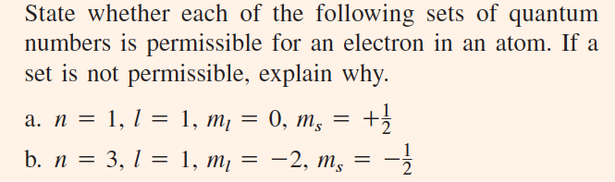

Applying the Rules for QN

Slide 42
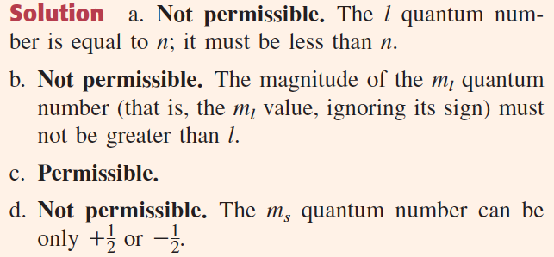
Applying the Rules for QN

Slide 43
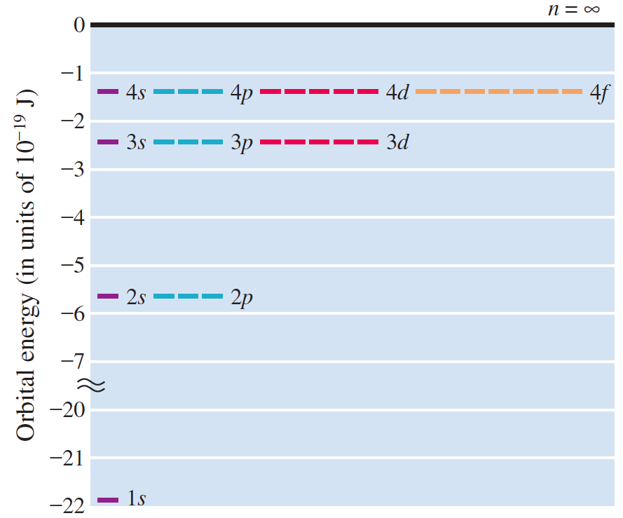
Orbital Energies of the H Atom

Slide 44
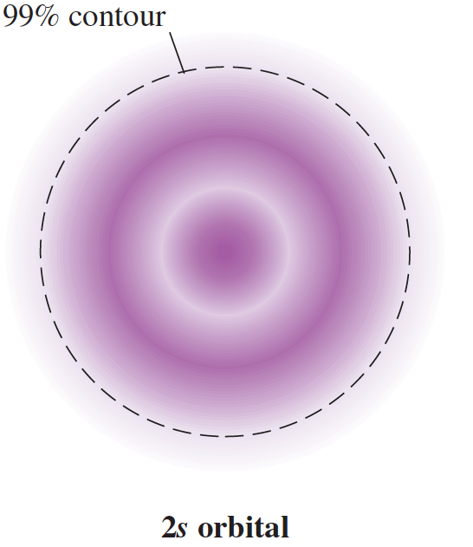
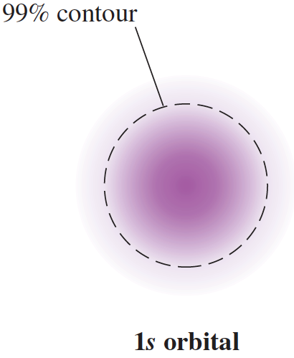
Atomic Orbitals Shape (Cross-Sectional Image)

Slide 45
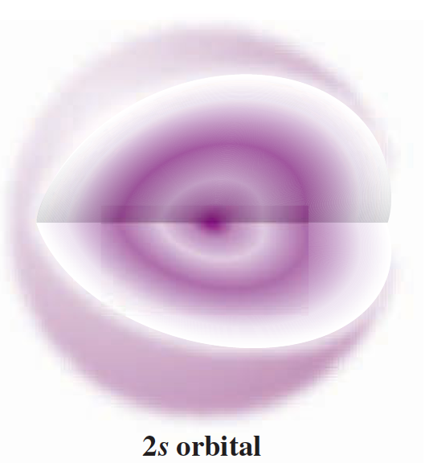
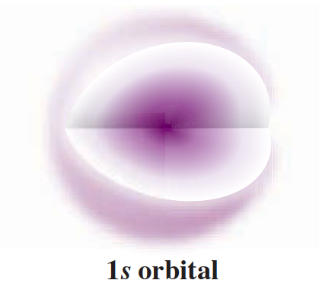
Atomic Orbitals Shape (3D Image)

Slide 46
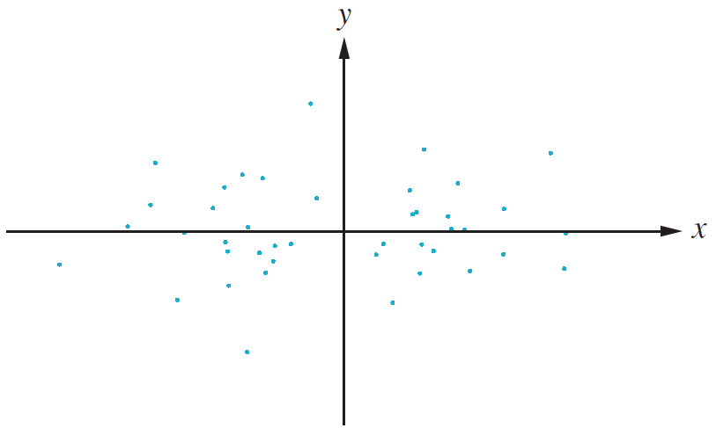
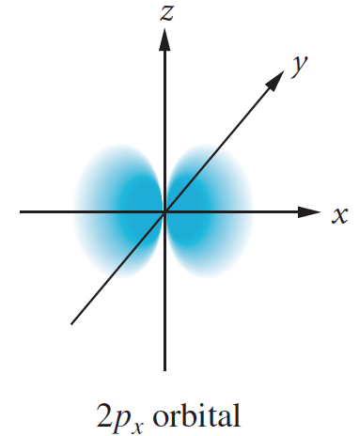
Electron Distribution in the p Orbitals

Slide 47
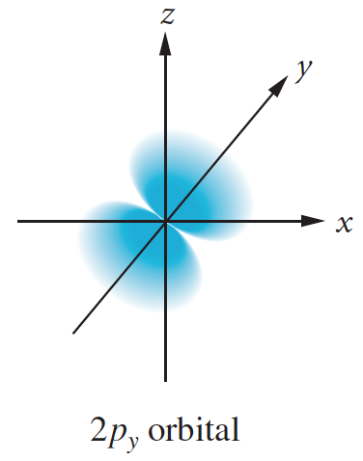
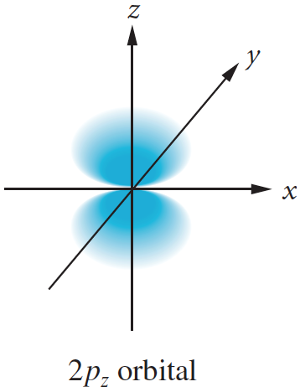
Orientations of the Three 2p Orbitals
Electron distribution in the 2p_{x}, 2p_{y}, 2p_{z} orbitals.
The drawings depict the general shape and orientation of the orbitals. Each orbital consists of two lobes oriented along the x-axis

Slide 48
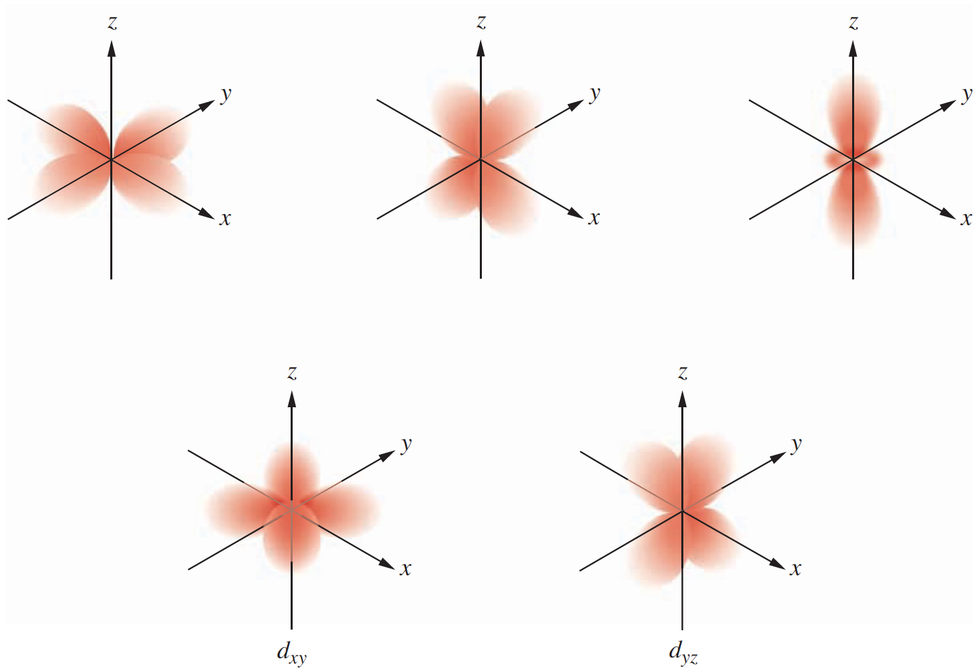
Orientations of the Five 3d Orbitals
d_{x2-y2}
d_{xz}
d_{z2}

